Slide 1
Microsoft Visual C#: An Introduction to Object-Oriented Programming
7th Edition
Chapter 5
Looping
© 2018 Cengage. All Rights Reserved. May not be copied, scanned, or duplicated, in whole or in part, except for use as permitted in a license distributed with a certain product or service or otherwise on a password-protected website for classroom use.

Slide 2
Objectives
5.1 Create loops using the while statement
5.2 Create loops using the for statement
5.3 Create loops using the do statement
5.4 Use nested loops
5.5 Accumulate totals
5.6 Understand how to improve loop performance
5.7 Appreciate looping issues in GUI programs
© 2018 Cengage. May not be copied, scanned, or duplicated, in whole or in part, except for use as permitted in a license distributed with a certain product or service or otherwise on a password-protected website for classroom use.

Slide 3
Creating Loops with the while Statement (1 of 11)
Loop
A structure that allows repeated execution of a block of statements
Loop body
A block of statements within a looping structure
Executes the Boolean expression to determine whether to continue to execute the loop or exit
Each execution is an Iteration
© 2018 Cengage. May not be copied, scanned, or duplicated, in whole or in part, except for use as permitted in a license distributed with a certain product or service or otherwise on a password-protected website for classroom use.

Slide 4
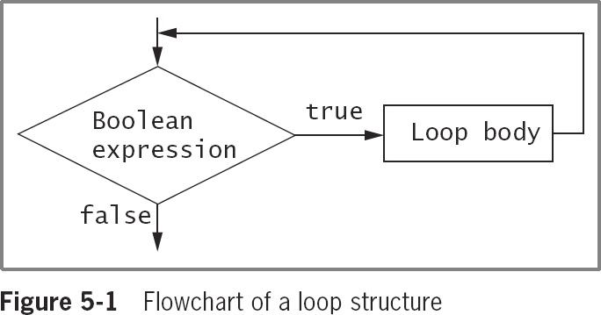
Creating Loops with the while Statement (2 of 11)
© 2018 Cengage. May not be copied, scanned, or duplicated, in whole or in part, except for use as permitted in a license distributed with a certain product or service or otherwise on a password-protected website for classroom use.

Slide 5
Creating Loops with the while Statement (3 of 11)
while loop
Used to execute a body of statements continuously as long as some condition continues to be true
Consists of:
The keyword while
A Boolean expression within parenthesis
The loop body
Infinite loop
A loop that never ends
A program with an infinite loop might eventually fail and end due to computer memory and hardware capacities
© 2018 Cengage. May not be copied, scanned, or duplicated, in whole or in part, except for use as permitted in a license distributed with a certain product or service or otherwise on a password-protected website for classroom use.

Slide 6
Creating Loops with the while Statement (4 of 11)
To make a while loop end correctly, three separate actions should occur:
A loop control variable is initialized
The loop control variable is tested in the while expression
The body of the loop must take some action that alters the value of the loop control variable
© 2018 Cengage. May not be copied, scanned, or duplicated, in whole or in part, except for use as permitted in a license distributed with a certain product or service or otherwise on a password-protected website for classroom use.

Slide 7
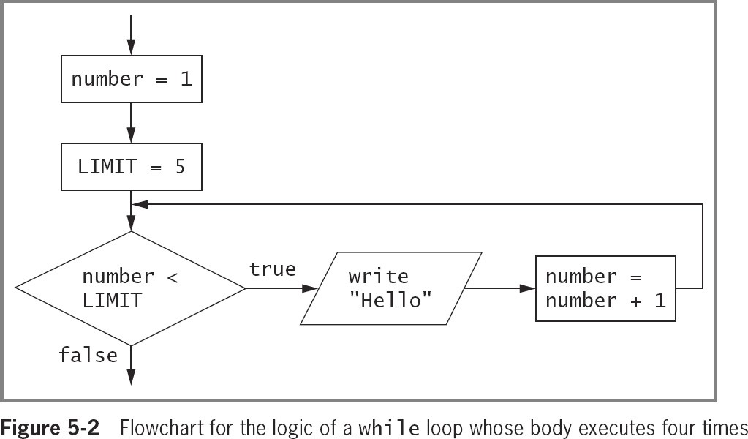
Creating Loops with the while Statement (5 of 11)
© 2018 Cengage. May not be copied, scanned, or duplicated, in whole or in part, except for use as permitted in a license distributed with a certain product or service or otherwise on a password-protected website for classroom use.

Slide 8
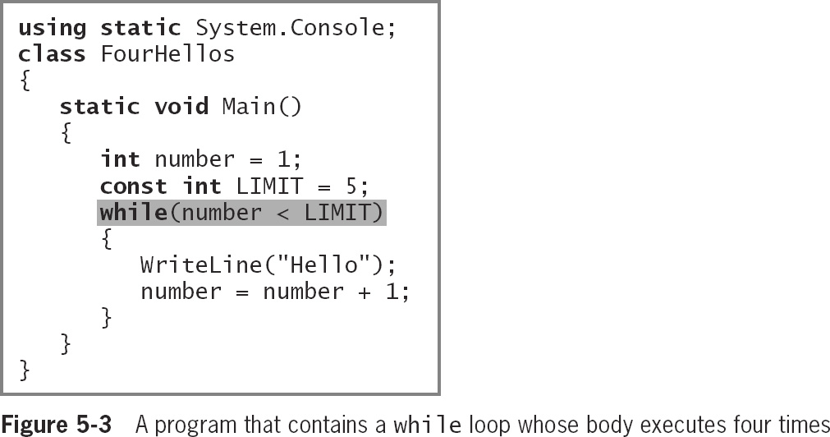
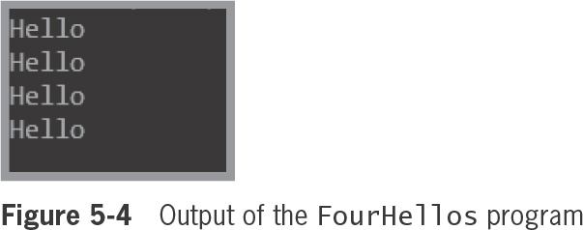
Creating Loops with the while Statement (6 of 11)
© 2018 Cengage. May not be copied, scanned, or duplicated, in whole or in part, except for use as permitted in a license distributed with a certain product or service or otherwise on a password-protected website for classroom use.

Slide 9
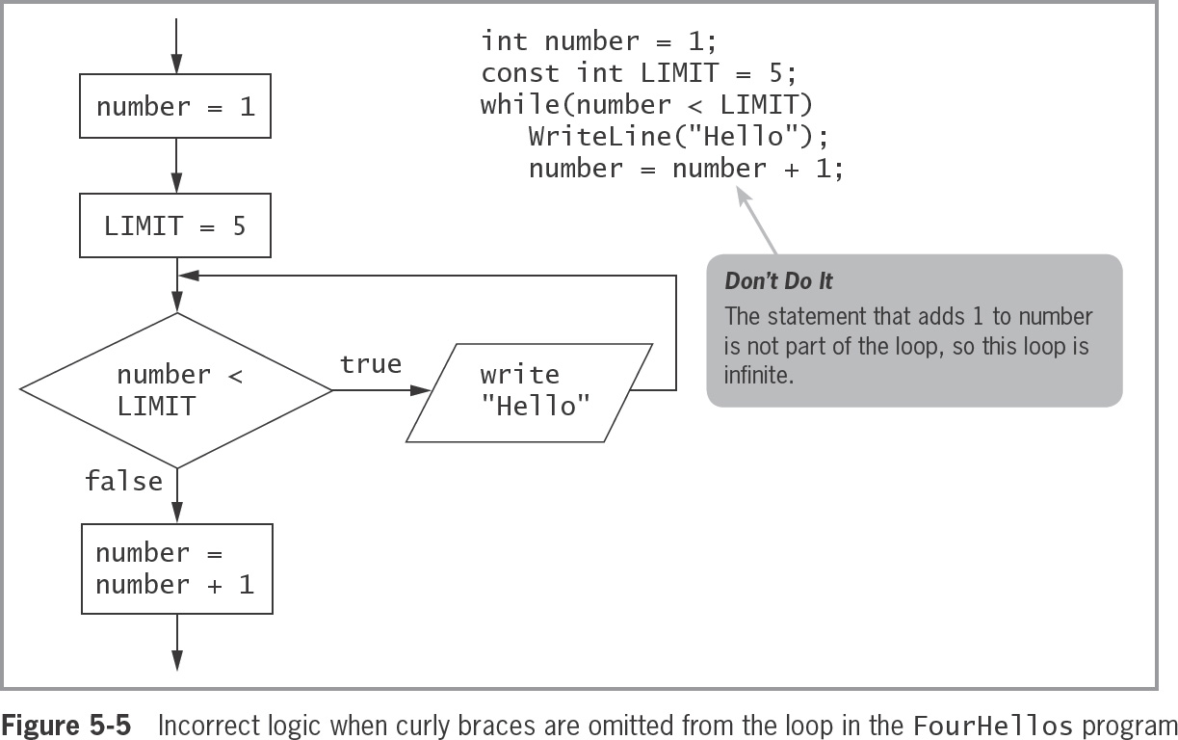
Creating Loops with the while Statement (7 of 11)
© 2018 Cengage. May not be copied, scanned, or duplicated, in whole or in part, except for use as permitted in a license distributed with a certain product or service or otherwise on a password-protected website for classroom use.

Slide 10
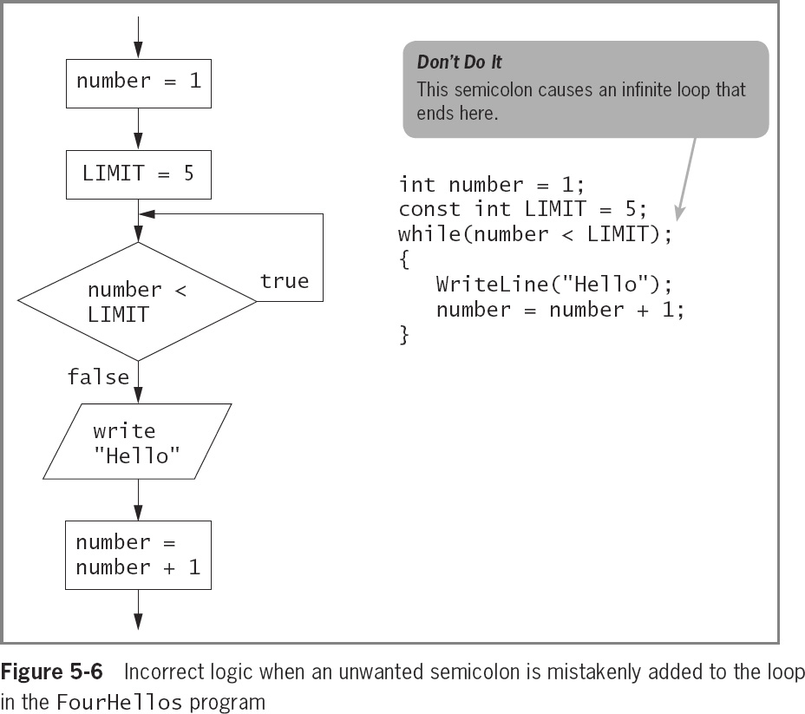
Creating Loops with the while Statement (8 of 11)
Empty body
A loop with no statements
Incrementing
Adding to the loop control variable
Decrementing
Subtracting from the loop control variable
© 2018 Cengage. May not be copied, scanned, or duplicated, in whole or in part, except for use as permitted in a license distributed with a certain product or service or otherwise on a password-protected website for classroom use.

Slide 11
Creating Loops with the while Statement (9 of 11)
Definite loop or counted loop
A loop for which the number of iterations is predetermined
Indefinite loop
The value of a loop control variable is not altered by arithmetic, but instead is altered by user input
Sentinel value
The value such as ‘Y’ or ‘N’ that a user must supply to stop the loop
© 2018 Cengage. May not be copied, scanned, or duplicated, in whole or in part, except for use as permitted in a license distributed with a certain product or service or otherwise on a password-protected website for classroom use.

Slide 12
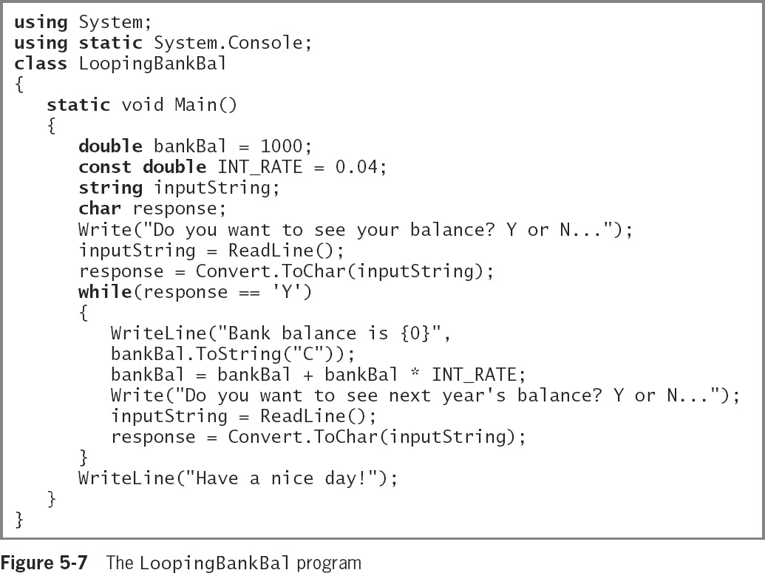
Creating Loops with the while Statement (10 of 11)
© 2018 Cengage. May not be copied, scanned, or duplicated, in whole or in part, except for use as permitted in a license distributed with a certain product or service or otherwise on a password-protected website for classroom use.

Slide 13
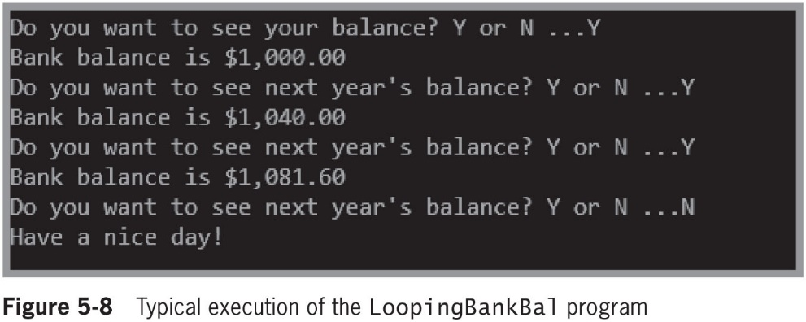
Creating Loops with the while Statement (11 of 11)
© 2018 Cengage. May not be copied, scanned, or duplicated, in whole or in part, except for use as permitted in a license distributed with a certain product or service or otherwise on a password-protected website for classroom use.

Slide 14
Creating Loops with the for Statement (1 of 3)
for loop
Used to create definite loops
Indicate the starting value for the loop control variable
Test the condition that controls loop entry
Allow the expression to alter the loop control variable
Known as the step value
Sections of the loop
Control variable initialization, testing and updating
Variables created inside the loop cease to exist when the loop ends
Known as out of scope
© 2018 Cengage. May not be copied, scanned, or duplicated, in whole or in part, except for use as permitted in a license distributed with a certain product or service or otherwise on a password-protected website for classroom use.

Slide 15
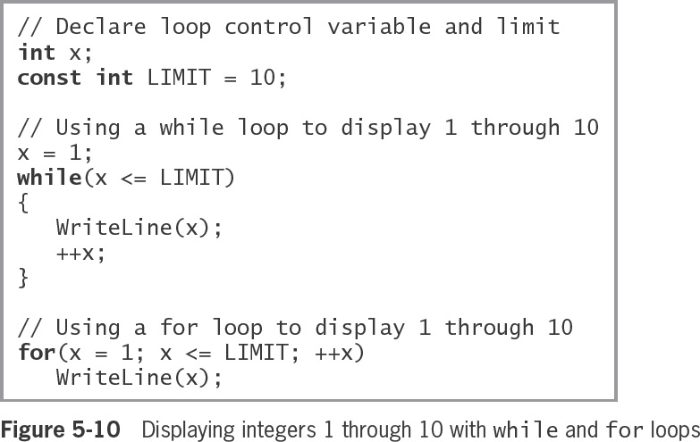
Creating Loops with the for Statement (2 of 3)
© 2018 Cengage. May not be copied, scanned, or duplicated, in whole or in part, except for use as permitted in a license distributed with a certain product or service or otherwise on a password-protected website for classroom use.

Slide 16
Creating Loops with the for Statement (3 of 3)
When a variable is declared inside a loop, it can be reference only for the duration of the loop body
When a variable can be accessed, it is in scope
When a loop body ends, any declarations made within it are out of scope
You can:
Perform more than one test in the middle section of the for statement by evaluating compound conditions
Perform tasks other than incrementing at the end of the loop’s execution
Perform multiple tasks at the end of the loop’s execution by separating the actions with commas
Leave one or more portions of the for expression empty, although the two semicolons are still required as placeholders to separate the three sections
© 2018 Cengage. May not be copied, scanned, or duplicated, in whole or in part, except for use as permitted in a license distributed with a certain product or service or otherwise on a password-protected website for classroom use.

Slide 17
Creating Loops with the do Statement (1 of 4)
do loop
Always enters the loop without testing
Checks at the “bottom” of the loop after one repetition has occurred
Also called a do…while loop
Convenient when you know you want to perform some task at least one time
The while loop and for loop are pretest loops—ones in which the loop control variable is tested before the loop body executes
The do loop is a posttest loop—one in which the loop control variable is tested after the loop body executes
© 2018 Cengage. May not be copied, scanned, or duplicated, in whole or in part, except for use as permitted in a license distributed with a certain product or service or otherwise on a password-protected website for classroom use.

Slide 18
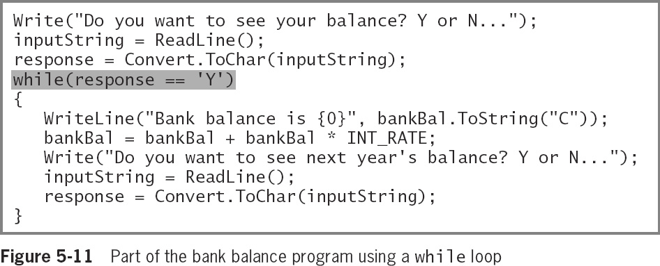
Creating Loops with the do Statement (2 of 4)
© 2018 Cengage. May not be copied, scanned, or duplicated, in whole or in part, except for use as permitted in a license distributed with a certain product or service or otherwise on a password-protected website for classroom use.

Slide 19
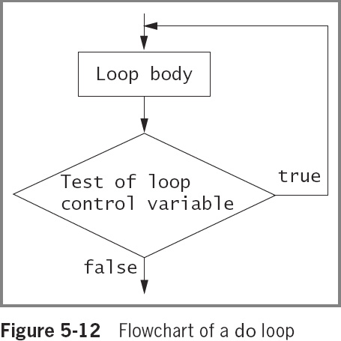
Creating Loops with the do Statement (3 of 4)
© 2018 Cengage. May not be copied, scanned, or duplicated, in whole or in part, except for use as permitted in a license distributed with a certain product or service or otherwise on a password-protected website for classroom use.

Slide 20
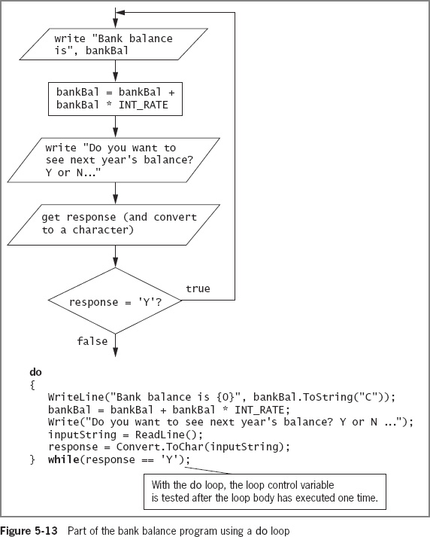
Creating Loops with the do Statement (4 of 4)
© 2018 Cengage. May not be copied, scanned, or duplicated, in whole or in part, except for use as permitted in a license distributed with a certain product or service or otherwise on a password-protected website for classroom use.

Slide 21
Using Nested Loops (1 of 4)
When loops are nested, each pair contains an inner loop and an outer loop
The inner loop must be entirely contained within the outer loop
Loops can never overlap
© 2018 Cengage. May not be copied, scanned, or duplicated, in whole or in part, except for use as permitted in a license distributed with a certain product or service or otherwise on a password-protected website for classroom use.

Slide 22
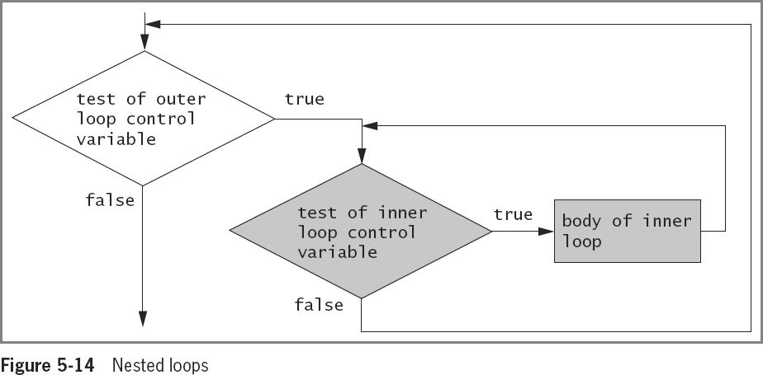
Using Nested Loops (2 of 4)
© 2018 Cengage. May not be copied, scanned, or duplicated, in whole or in part, except for use as permitted in a license distributed with a certain product or service or otherwise on a password-protected website for classroom use.

Slide 23
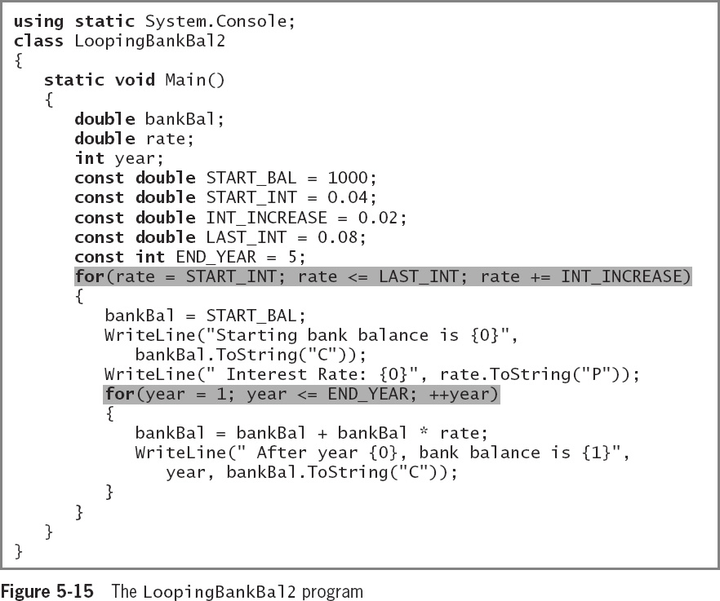
Using Nested Loops (3 of 4)
© 2018 Cengage. May not be copied, scanned, or duplicated, in whole or in part, except for use as permitted in a license distributed with a certain product or service or otherwise on a password-protected website for classroom use.

Slide 24
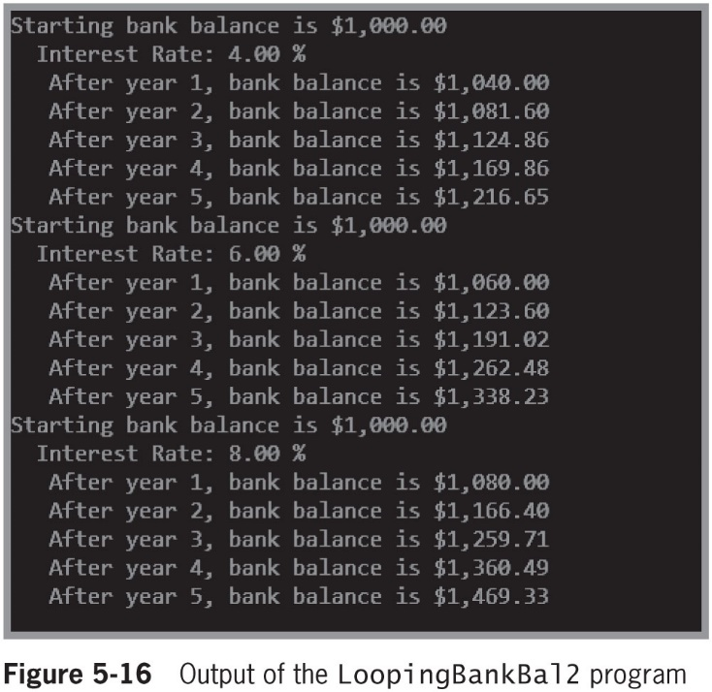
Using Nested Loops (4 of 4)
© 2018 Cengage. May not be copied, scanned, or duplicated, in whole or in part, except for use as permitted in a license distributed with a certain product or service or otherwise on a password-protected website for classroom use.

Slide 25
Accumulating Totals (1 of 3)
Totals are accumulated
Gathered together and added into a final sum by processing individual records one at a time in a loop
Garbage
An unknown value
The C# compiler helps to prevent seeing an incorrect total by requiring you to provide a starting value
C# will not use the garbage value that happens to be stored at an uninitialized memory location
© 2018 Cengage. May not be copied, scanned, or duplicated, in whole or in part, except for use as permitted in a license distributed with a certain product or service or otherwise on a password-protected website for classroom use.

Slide 26
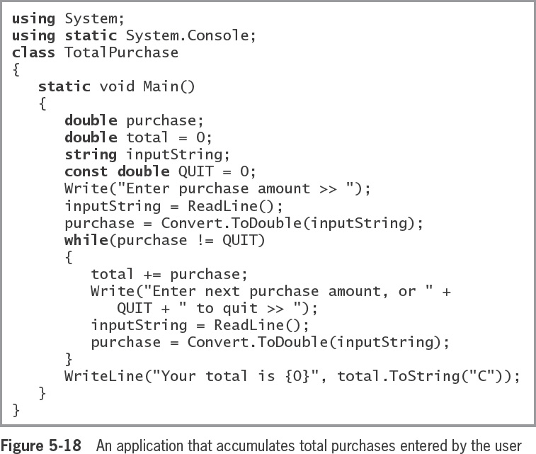
Accumulating Totals (2 of 3)
© 2018 Cengage. May not be copied, scanned, or duplicated, in whole or in part, except for use as permitted in a license distributed with a certain product or service or otherwise on a password-protected website for classroom use.

Slide 27
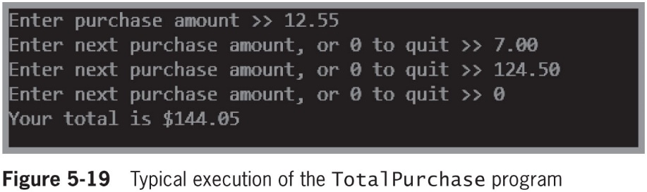
Accumulating Totals (3 of 3)
© 2018 Cengage. May not be copied, scanned, or duplicated, in whole or in part, except for use as permitted in a license distributed with a certain product or service or otherwise on a password-protected website for classroom use.

Slide 28
Improving Loop Performance
Make sure the loop avoids unnecessary operations
Consider the order of evaluation for short-circuit operators
Employ loop fusion
Use prefix incrementing rather than postfix incrementing
© 2018 Cengage. May not be copied, scanned, or duplicated, in whole or in part, except for use as permitted in a license distributed with a certain product or service or otherwise on a password-protected website for classroom use.

Slide 29
Avoiding Unnecessary Operations
A loop should execute while x is less than the sum of two integers a and b, and that neither a nor b is altered in the loop body. The loop could be written as:
while (x < a + b)
// loop body
- or -
int sum = a + b;
while (x < sum)
// loop body
In the code on the left this loop executes 1,000 times and the expression a + b is calculated 1,000 times
In the code on the right, the results are the same, but the arithmetic is performed only once
© 2018 Cengage. May not be copied, scanned, or duplicated, in whole or in part, except for use as permitted in a license distributed with a certain product or service or otherwise on a password-protected website for classroom use.

Slide 30
Considering the Order of Evaluation of Short-Circuit Operators
Remember that the expressions in each part of an AND or OR expression use short-circuit evaluation
When a loop might execute many times, it becomes increasingly important to consider the number of evaluations that take place
If you believe that the first Boolean expression is more likely to be true than the second one, you can eliminate testing the second one on more occasions
© 2018 Cengage. May not be copied, scanned, or duplicated, in whole or in part, except for use as permitted in a license distributed with a certain product or service or otherwise on a password-protected website for classroom use.

Slide 31
Employing Loop Fusion
Loop Fusion is the technique of combining two loops into one
for(int x = 0; x < TIMES; ++x)
method1();
for(int x = 0; x < TIMES; ++x)
method2();
for(int x = 0; x < TIMES; ++x)
{
method1();
method2();
}
Fusing loops will not work in every situation
Sometimes all the activities for each execution of method1() must be finished before any of those in method2() can begin
© 2018 Cengage. May not be copied, scanned, or duplicated, in whole or in part, except for use as permitted in a license distributed with a certain product or service or otherwise on a password-protected website for classroom use.

Slide 32
Using Prefix Incrementing Rather Than Postfix Incrementing (1 of 2)
Example:
for(int x = 0; x < LIMIT; x++)
Because incrementing x is a stand-alone statement in the for loop, the result is identical whether you use x++ or ++x
++x runs faster than x++
A way to prove the prefix increment operator produces a faster loop is to use C#’s Stopwatch class
Stopwatch sw = Stopwatch.StartNew();
// Place statement to be time here
sw.Stop();
© 2018 Cengage. May not be copied, scanned, or duplicated, in whole or in part, except for use as permitted in a license distributed with a certain product or service or otherwise on a password-protected website for classroom use.

Slide 33
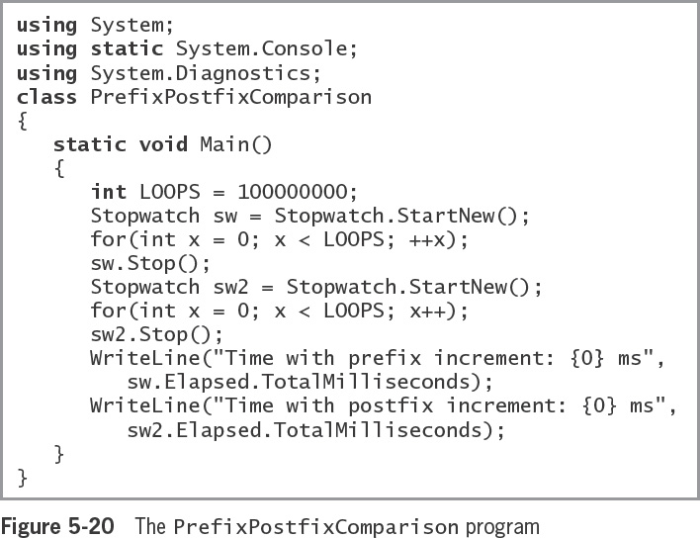
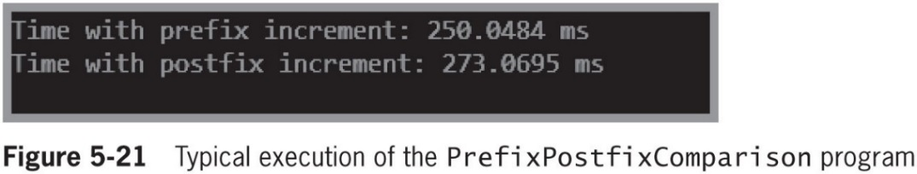
Using Prefix Incrementing Rather Than Postfix Incrementing (2 of 2)
© 2018 Cengage. May not be copied, scanned, or duplicated, in whole or in part, except for use as permitted in a license distributed with a certain product or service or otherwise on a password-protected website for classroom use.

Slide 34
Looping Issues in GUI Programs (1 of 5)
Using a loop within a method in a GUI application is no different from using one in a console application
Event-driven programs sometimes require fewer coded loops
Some events are determined by the user’s actions when the program is running, rather than by the programmer’s coding
You can write an event-driven program so that an action continues as long as the user continues to make an appropriate selection
© 2018 Cengage. May not be copied, scanned, or duplicated, in whole or in part, except for use as permitted in a license distributed with a certain product or service or otherwise on a password-protected website for classroom use.

Slide 35
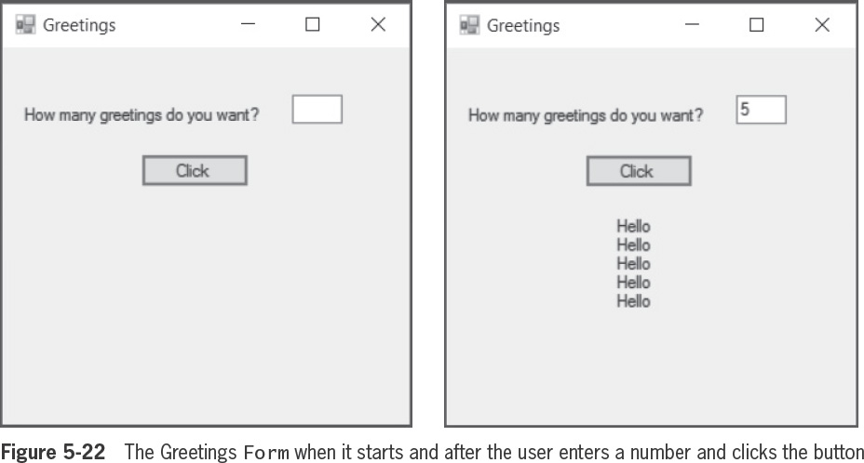
Looping Issues in GUI Programs (2 of 5)
© 2018 Cengage. May not be copied, scanned, or duplicated, in whole or in part, except for use as permitted in a license distributed with a certain product or service or otherwise on a password-protected website for classroom use.

Slide 36
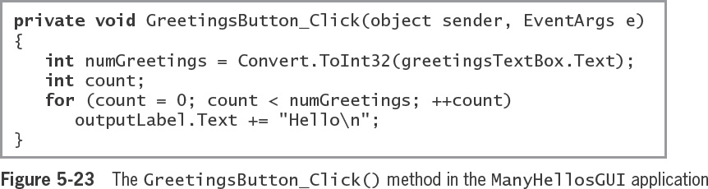
Looping Issues in GUI Programs (3 of 5)
© 2018 Cengage. May not be copied, scanned, or duplicated, in whole or in part, except for use as permitted in a license distributed with a certain product or service or otherwise on a password-protected website for classroom use.

Slide 37
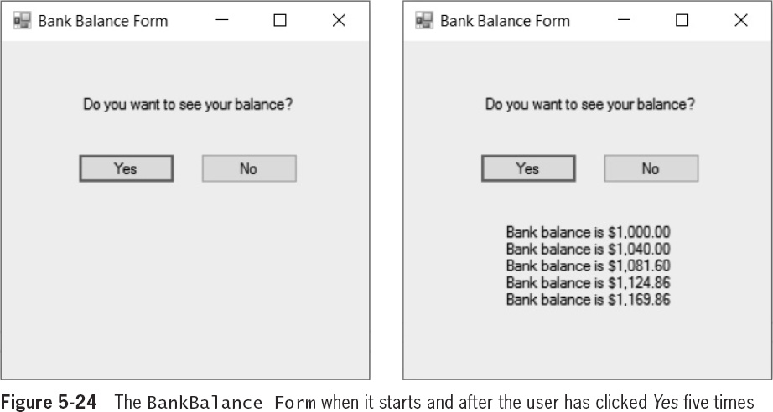
Looping Issues in GUI Programs (4 of 5)
© 2018 Cengage. May not be copied, scanned, or duplicated, in whole or in part, except for use as permitted in a license distributed with a certain product or service or otherwise on a password-protected website for classroom use.

Slide 38
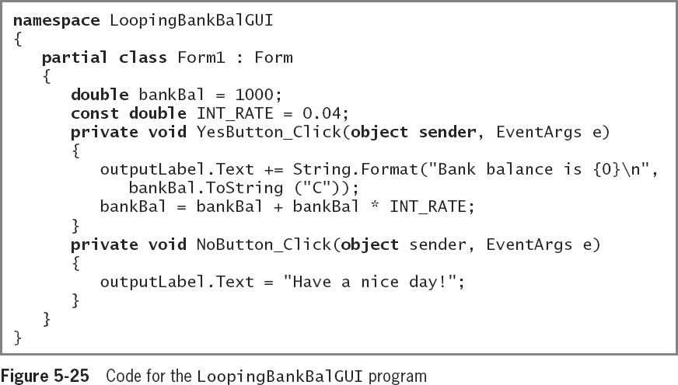
Looping Issues in GUI Programs (5 of 5)
© 2018 Cengage. May not be copied, scanned, or duplicated, in whole or in part, except for use as permitted in a license distributed with a certain product or service or otherwise on a password-protected website for classroom use.

Slide 39
Chapter Summary (1 of 2)
Use a while loop to execute a body of statements continuously while some condition continues to be true
When using a for statement, you can indicate in one place:
The starting value for the loop control variable
The test condition that controls loop entry
The expression that alters the loop control variable
The do loop checks the “bottom” of the loop after one repetition has occurred
You can nest any combination of loops to achieve the desired results
© 2018 Cengage. May not be copied, scanned, or duplicated, in whole or in part, except for use as permitted in a license distributed with a certain product or service or otherwise on a password-protected website for classroom use.

Slide 40
Chapter Summary (2 of 2)
In computer programs, totals frequently are accumulated
Improve loop performance by making sure the loop does not include unnecessary operations
You can use while, for, and do...while loops in the same ways as in console and GUI programs
© 2018 Cengage. May not be copied, scanned, or duplicated, in whole or in part, except for use as permitted in a license distributed with a certain product or service or otherwise on a password-protected website for classroom use.

